Slide 1

Overview of Google Colab
Data Analytics Department
Bridgerland Technical College

Slide 2
Content
How to create a Google Colab account
How to create a Colab notebook
How to upload your data file
How to run your code
How to download a .py and .ipynb file
How to save your file in Google Drive and GitHub
What to find in Colab in general
How to load a data file into a DataFrame
How to save a .ipynb file as a PDF file

Slide 3
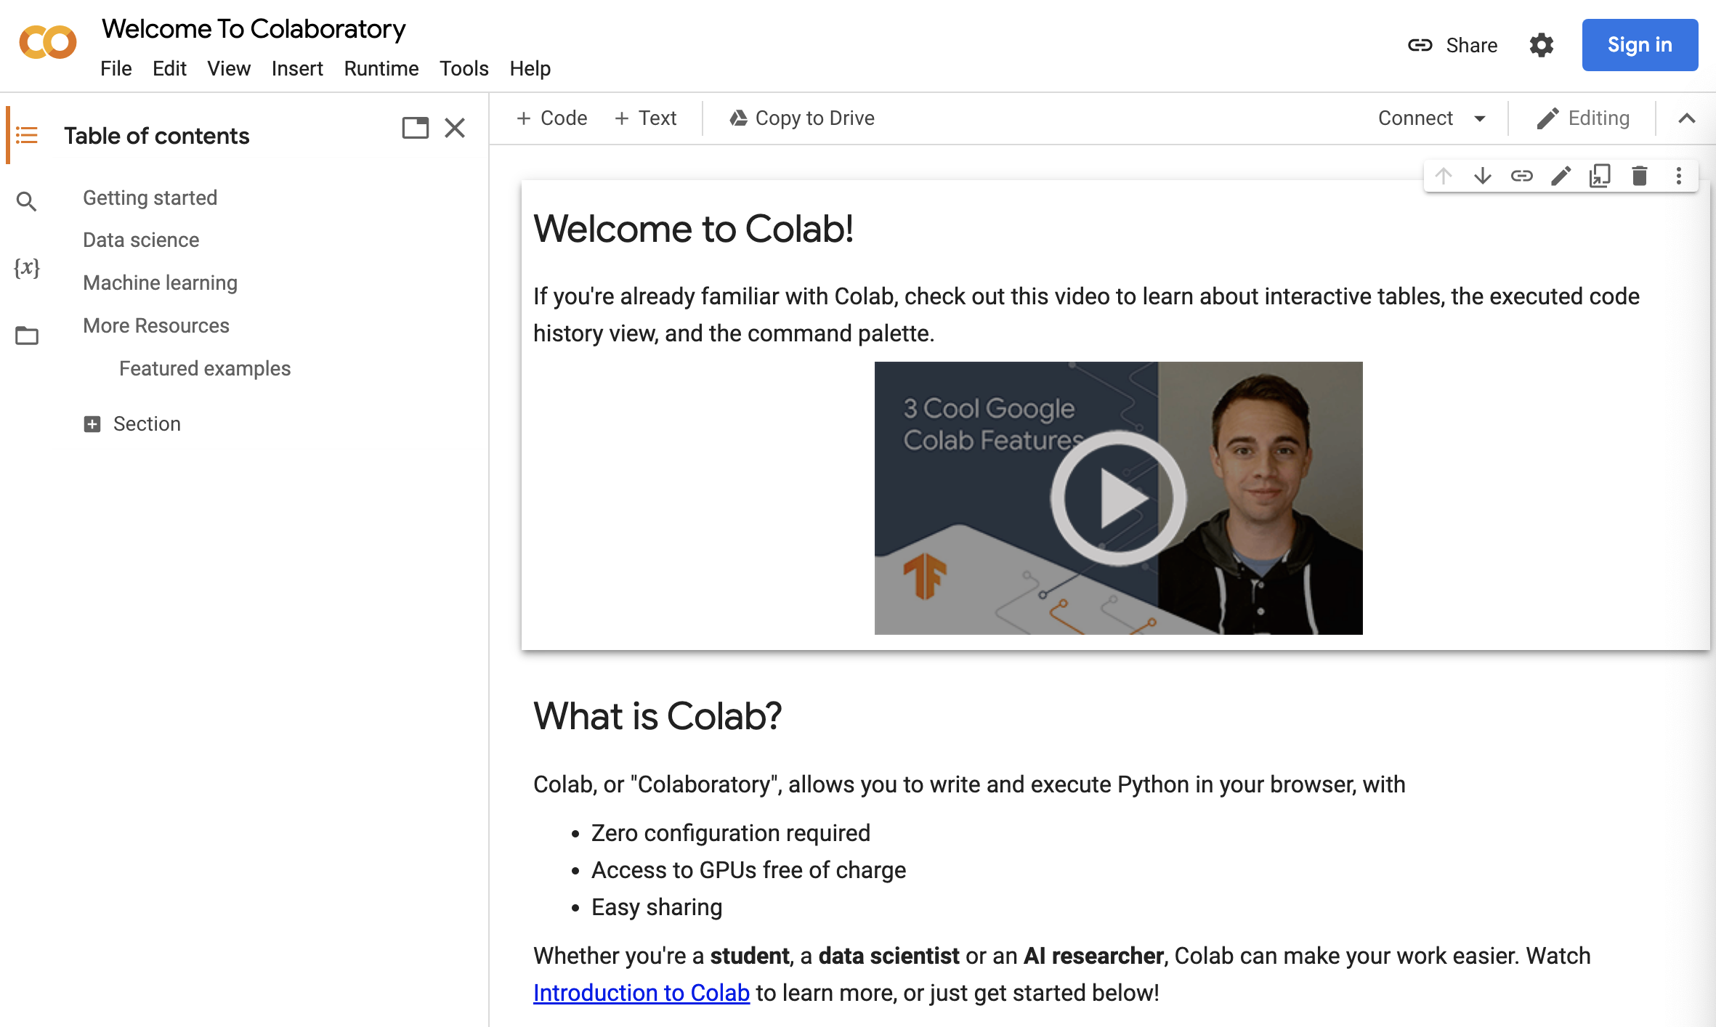

How to create a Google Colab account
You can sign in with your Gmail account or your school email.
What is Colab?

Slide 4
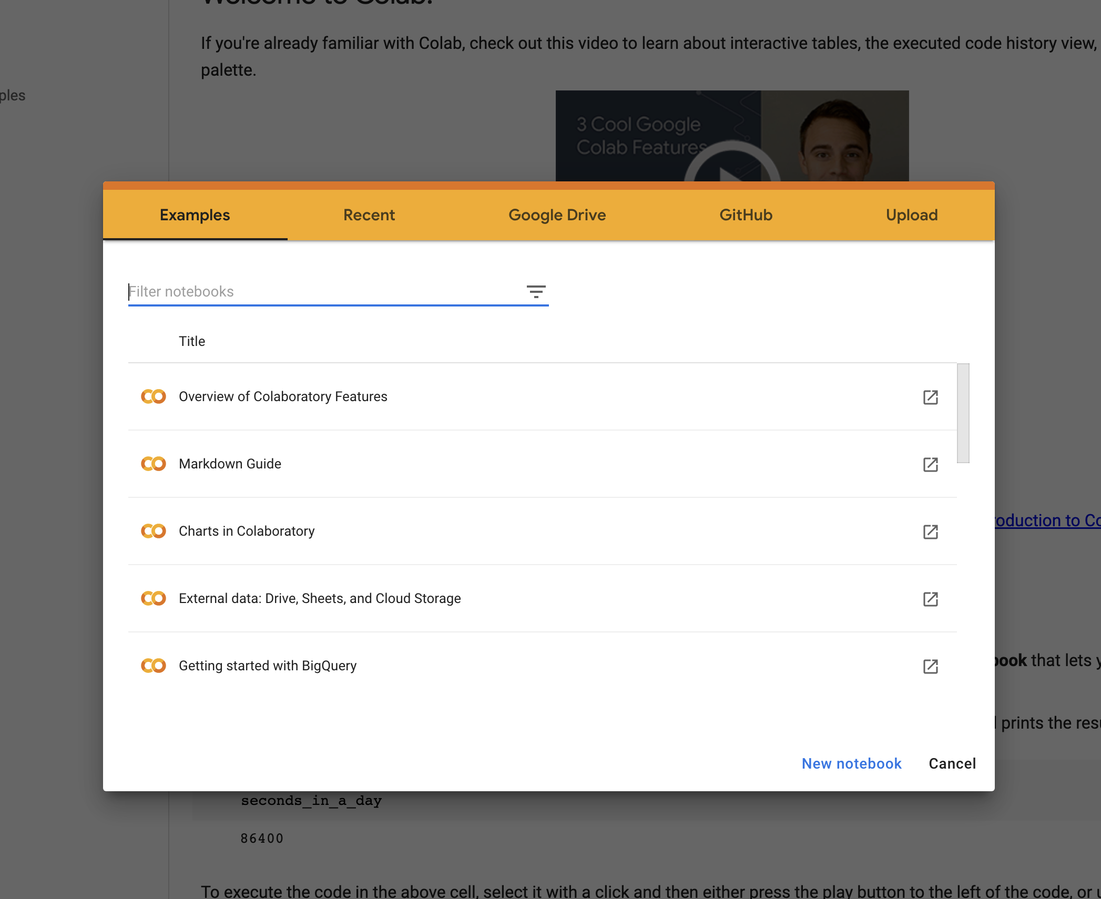
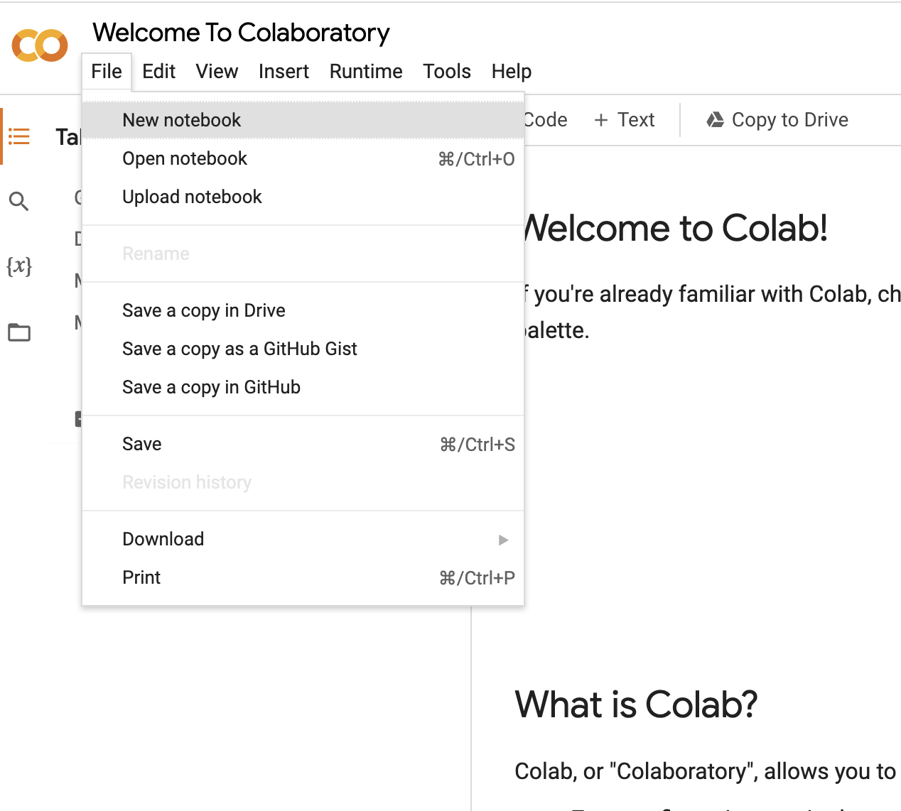
How to create a Colab notebook
You can use these two ways to open a new notebook

Slide 5
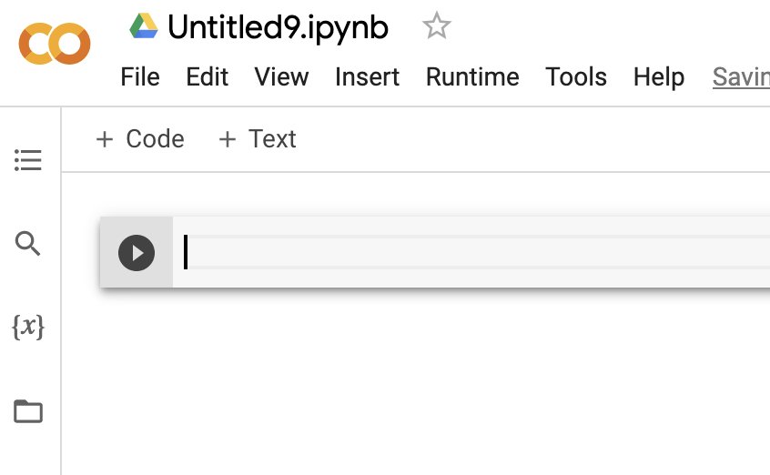
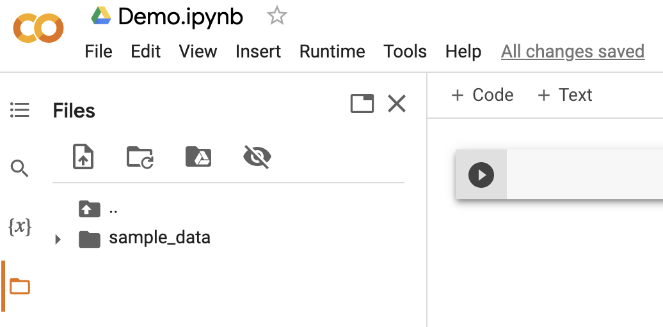


How to upload a data file
First, change the name of your file
This option will open the option for uploading the data file
It opens the “Files” section

Slide 6
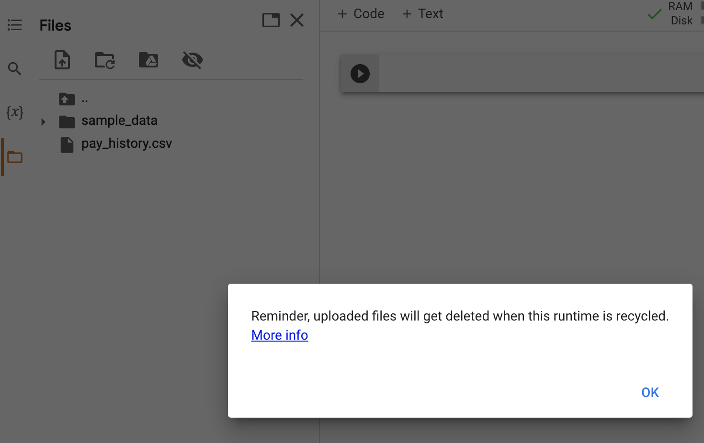

How to upload a data file
Click here to upload the data file (temporary)
You can see the uploaded file here
See the reminder

Slide 7
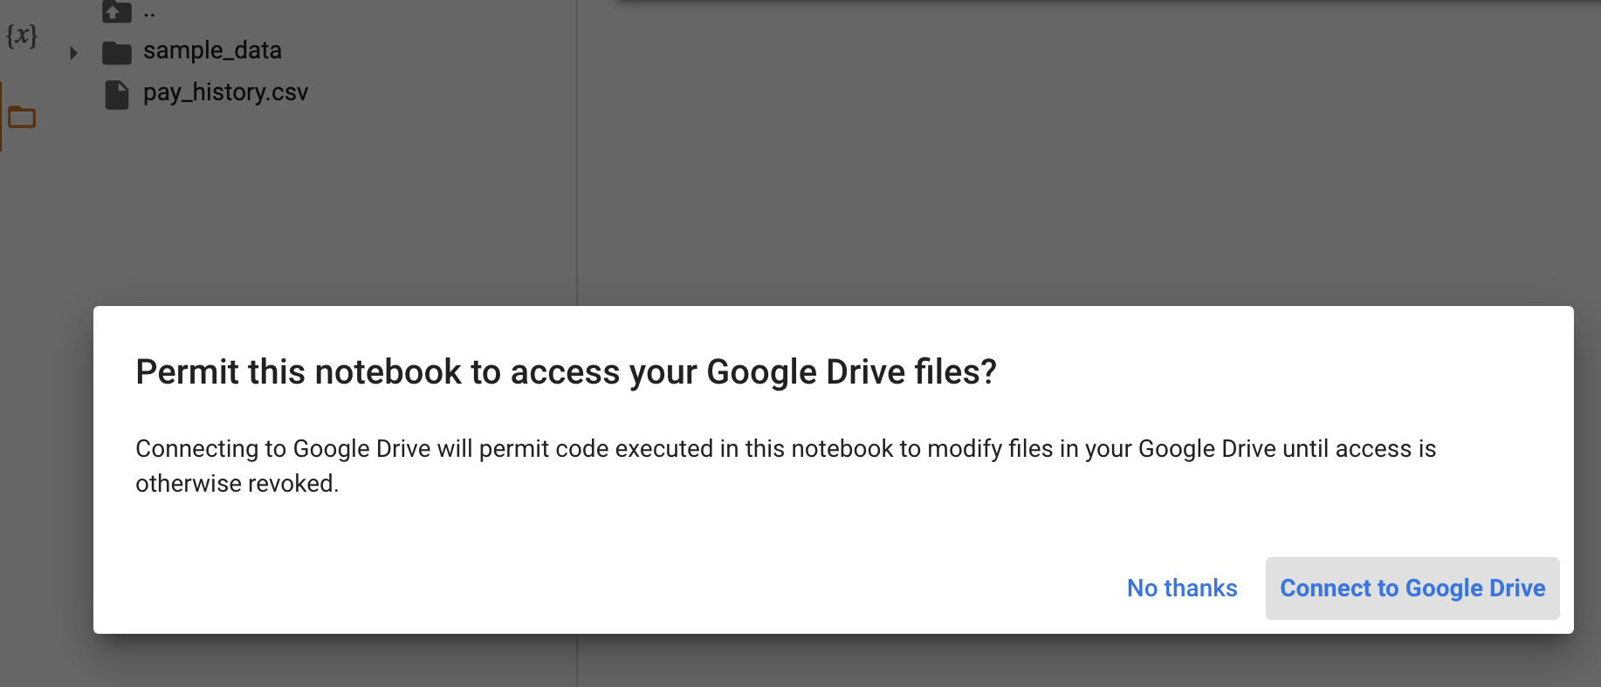

How to upload a data file
This option allows you to upload the data file in your drive.
Click here to connect to your Google drive

Slide 8
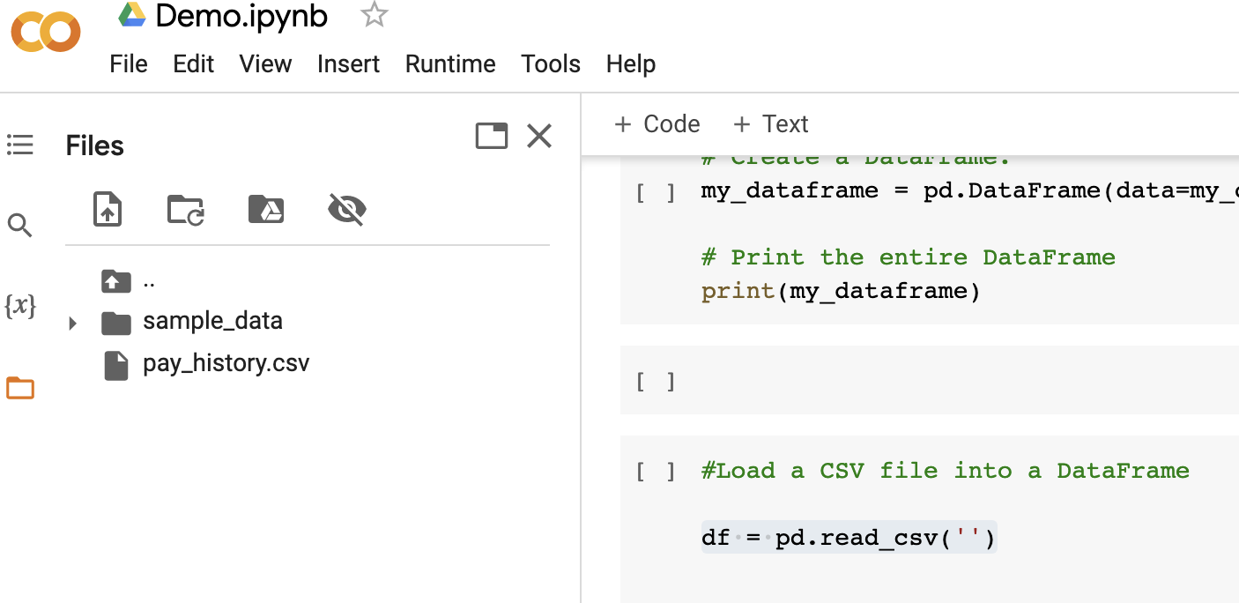

How to load a data file into a DataFrame
Here is the uploaded file
Code for loading the CSV file into a DataFrame

Slide 9
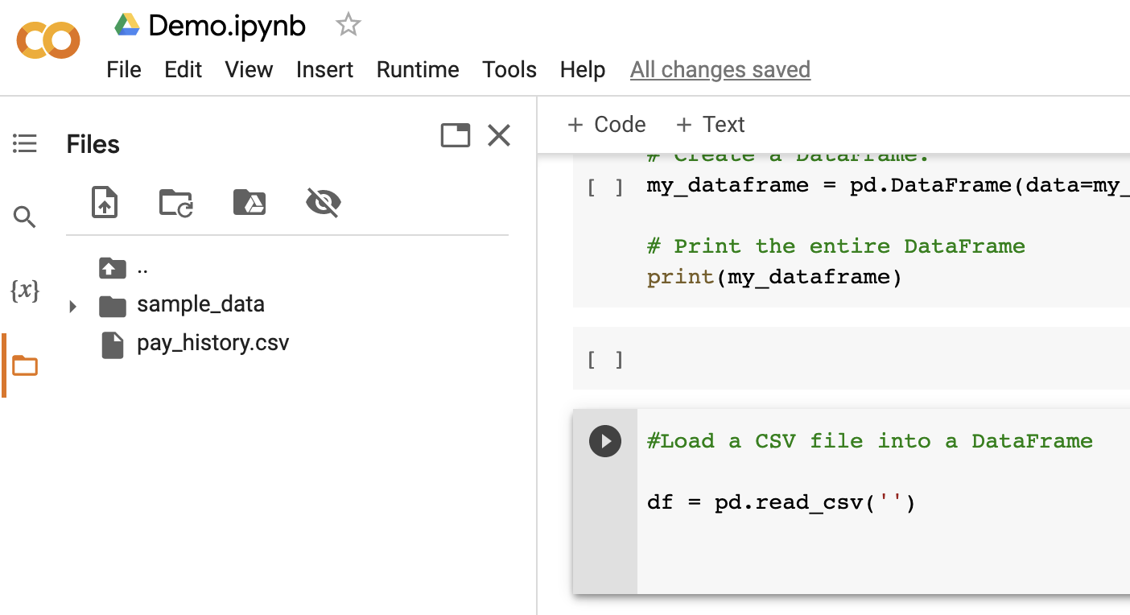
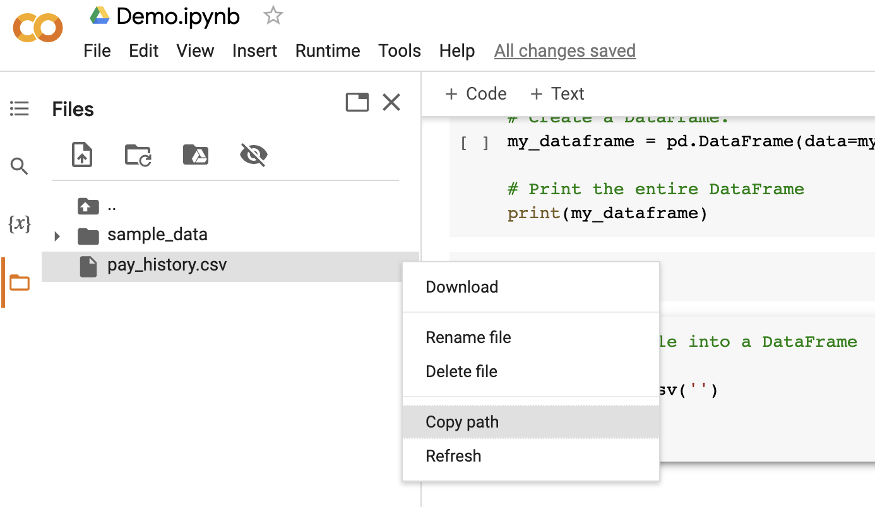
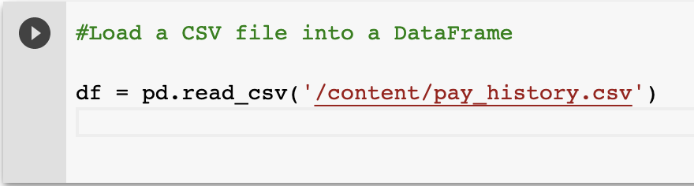
How to load a data file into a DataFrame
Here we need the file path
Click on the three dots and select “copy path”

Slide 10
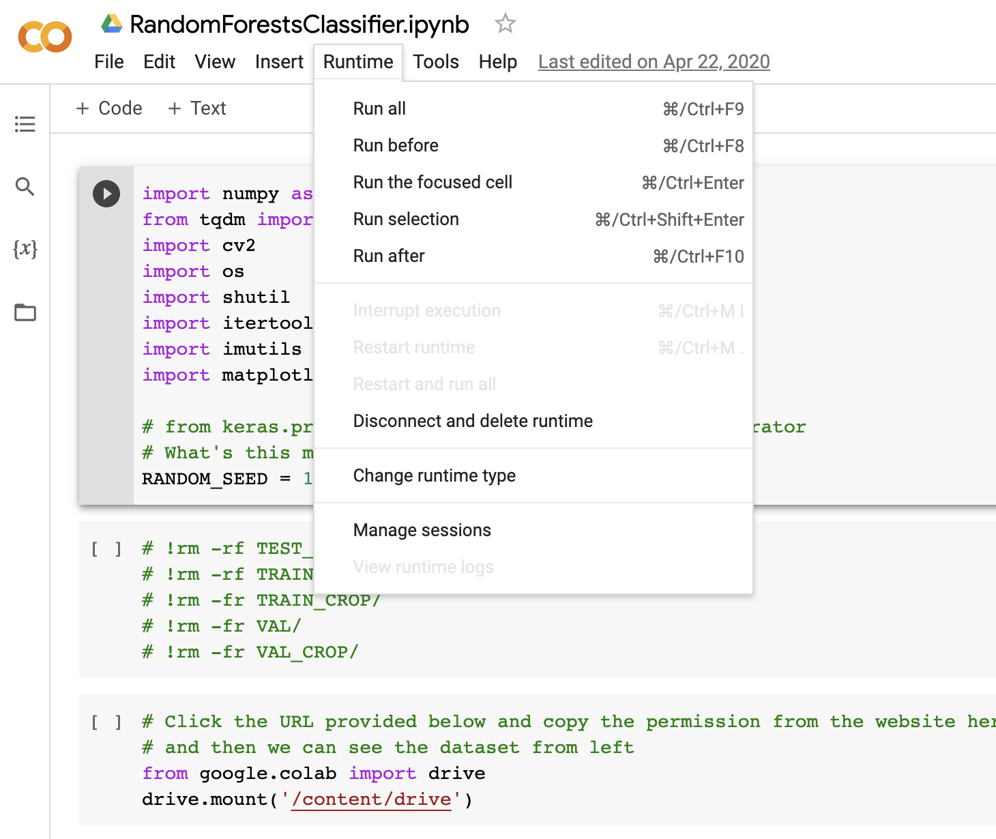
How to run your code
Runtime option: You can see other options here for running your code.
You can run your code as a block.

Slide 11
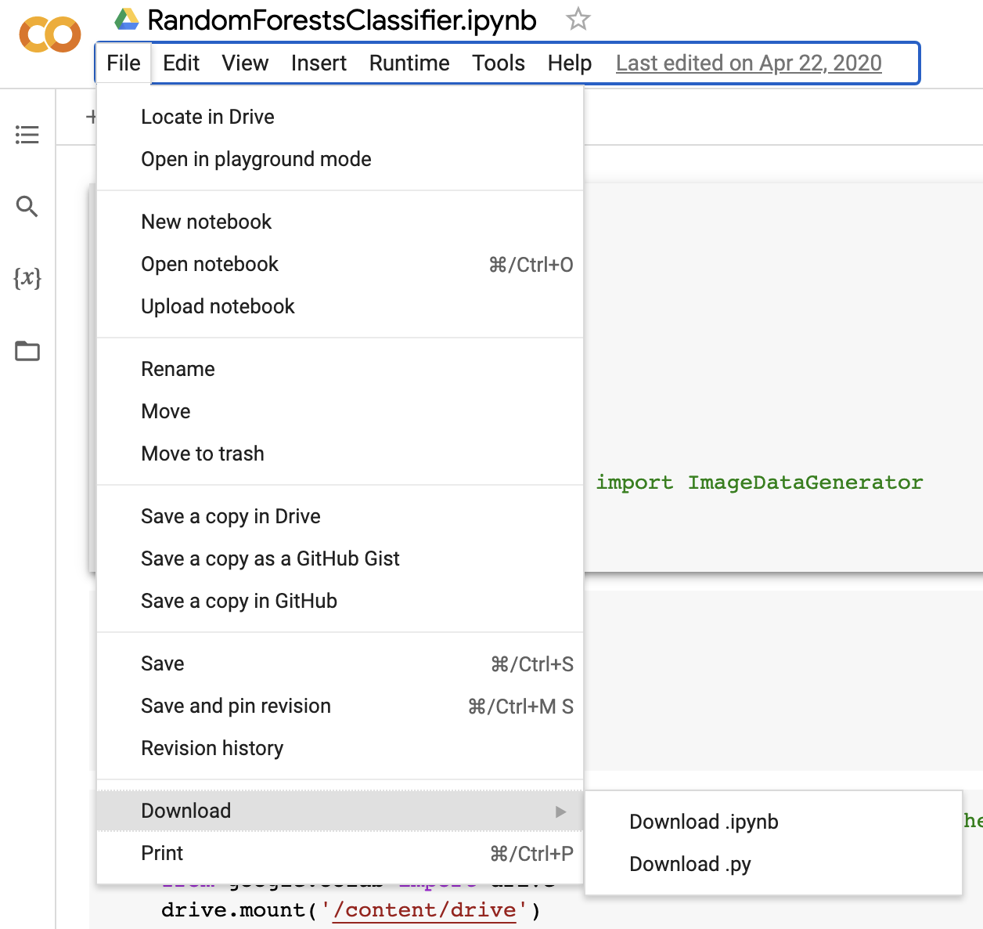

How to download a .py and .ipynb file
You can see the two options here.

Slide 12
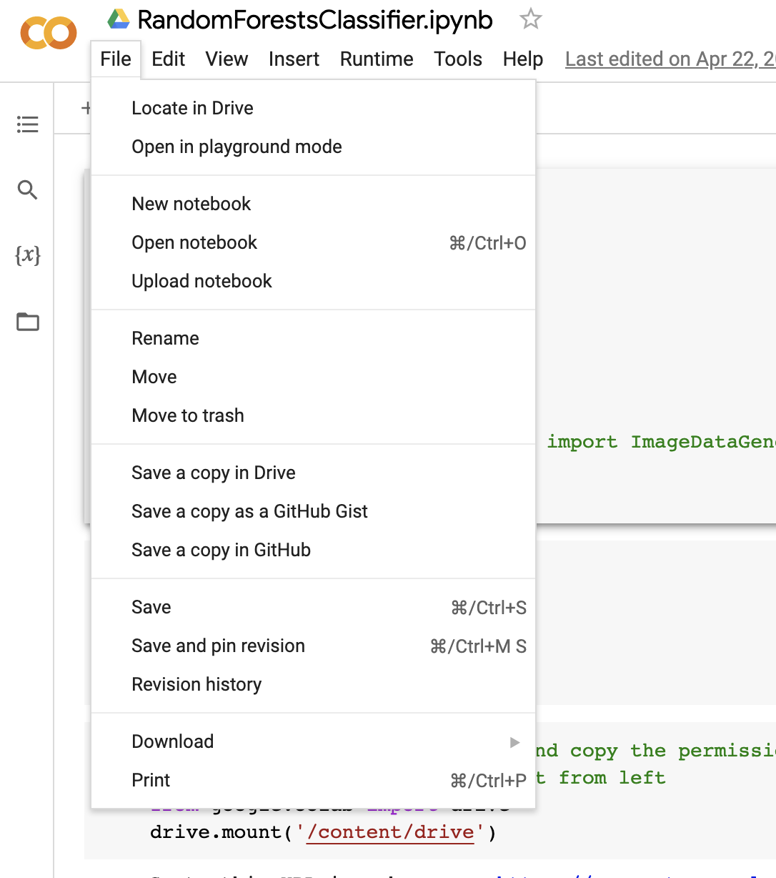

How to save your file in Google Drive and GitHub
Here are the options to save the file in Drive and GitHub

Slide 13
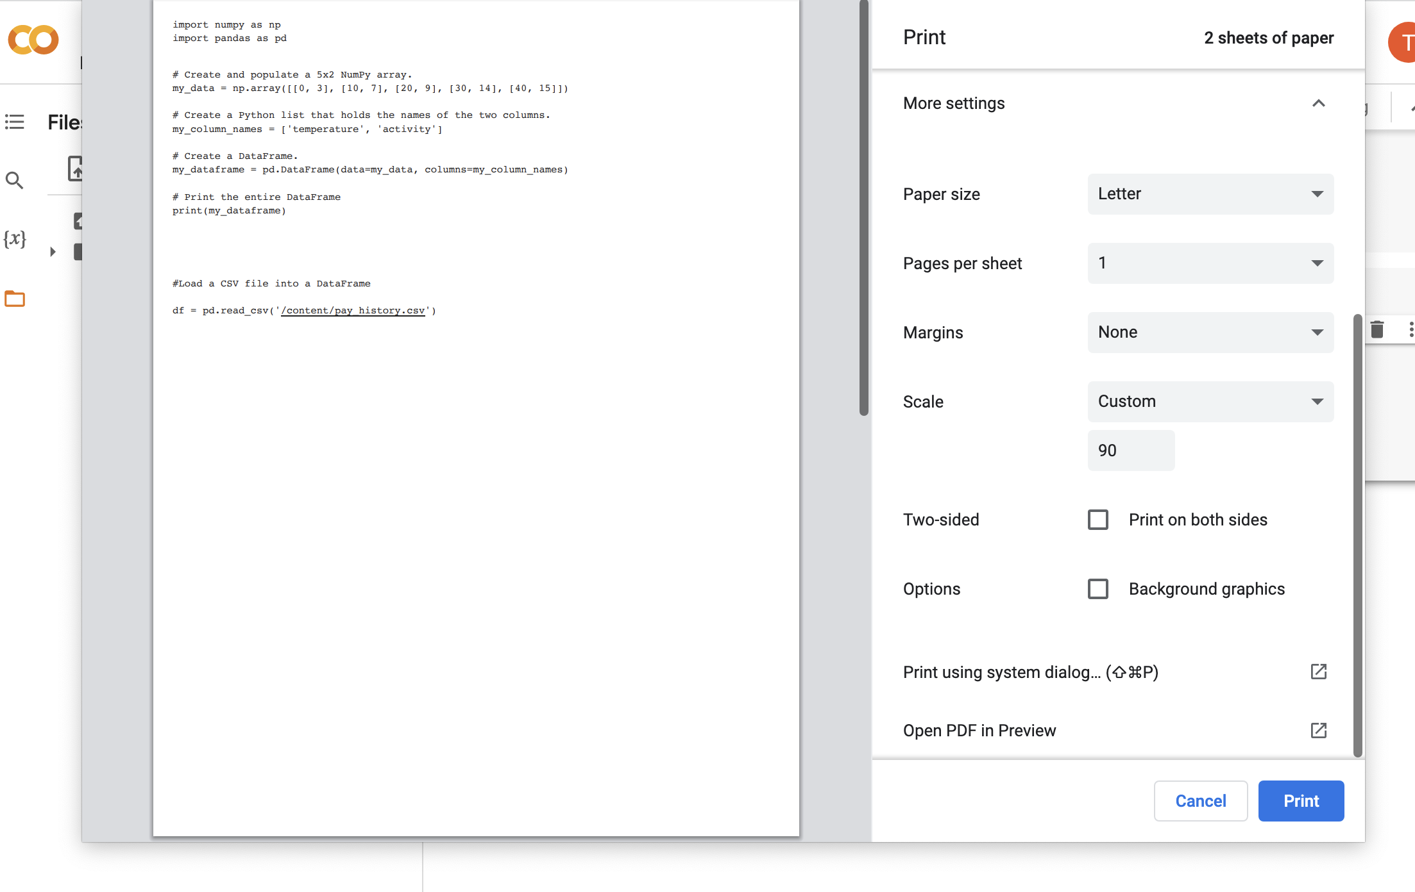
How to save a ipynb file as a PDF file
Go to “File” and click “Print”
If we click this option, we can have a preview of the file and export it as a PDF file.

Slide 14
What to find in Google Colab in General
You can find different tutorials such
Machine learning tutorial
Pandas DataFrame tutorial
TensorFlow tutorial
Data Science
Others
Links:
Machine Learning: https://colab.research.google.com/?utm_source=scs-index#scrollTo=OwuxHmxllTwN
Pandas: https://colab.research.google.com/github/google/eng-edu/blob/main/ml/cc/exercises/pandas_dataframe_ultraquick_tutorial.ipynb
Overview: https://colab.research.google.com/notebooks/basic_features_overview.ipynb

Slide 15

Questions?

